Slide 1


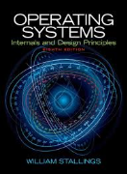
Welcome to
CS 345 Operating Systems
Chapter 3 - Processes (08)

Slide 2


Tip #8: Toothbrushes vs. Combs
When grouping related items, there are two layout possibilities:
The 'toothbrush' layout has a handle which sticks out a long way, with the bristles at the end.
  Makes the handle very visible and easy to find and read.
  May result in uneven, less readable, indentation and tramping across the page towards the right margin.
  struct CHAR_TYPE {
  unsigned int FontName;
  unsigned int Point;
  };
A more common approach is to use the 'comb' layout, which has only a small handle, with the bristles in a standard position.
  struct CHAR_TYPE
  {
  unsigned int FontName;
  unsigned int Point;
  };
http://syque.com/cstyle/contents.htm

Slide 3

Why is Linux so complicated?
First of all, Linux is not more complicated than Windows 10 or MacOS. The complexity is, however, not concealed very well.
Linux is not the design of a single person or a small team with a vision.
  It is the product of a glorious scrum of competing visions and individual contributors.
  As such, the various pieces and parts, designed to different aesthetics, tend to clash a bit where they meet. Those differences often show through.
  Worse, maintenance isn’t as fun as new coding, so people change things that were working just fine, and half the community adopts the new different thing, even though it just does the same stuff in a new way but with added complexity.
Nothing gets thrown away
  For example, there is no single email program everyone uses. Every mail program ever written for Unix or Linux is still around and likely available to you with a single download. Linux sometimes looks complicated because there are forty eleven ways to do anything you might want to do.
  This also can make it difficult to look for solutions on the internet, because there will be a hundred solutions out there, each of which will work in some slightly different context.

Slide 4
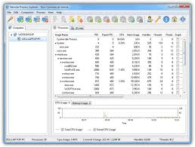
Chapter 3 – Processes
Part 1

Slide 5
Why is Linux so complicated?
There is no boundary
  With Windows or MacOS, it is what comes in the box. No one confuses Microsoft Office as being part of Windows, or Corel Draw or whatever. In contrast, there are many many thousands of applications which run on Linux, which can be installed with the click of a package manager, or even included willy nilly with a distribution. No one has any idea what is Linux and what is some third party app. Should Linux get the blame for some incoherent graphics editor?
  So yes. It can be as complicated as you like. If you like “works with no fuss as long as you don’t change anything” then distributions like Ubuntu aren’t bad. Such things are a curated packaging from the bazaar of Linux, that have in fact undergone some testing for obvious failings and will probably work as long as you stay on the paths.
  I’ll add that you shouldn’t confuse complicated with flakey. Linux, by and large, is not at all flakey. Systems I use regularly stay up with no fuss for six months or a year or until a power failure occurs. (I find MacOS just about as good at reliability, and I am not really a Windows user.)

Slide 6













New Building Construction
  Identify
  Computer
  Data
  Context
  Programs
  Interrupts
Builder (General Contractor)
Operating System
Materials
Scheduling
  2 State
  5 state
Workers
Consumeable
Resources
  States
  New
  Working
  Waiting
  Blocked
  Suspended
  Completed
New Building
Task or Process
Tools
Threads
Reusable
Libraries
What needs to be Managed?

Slide 7
Follow-up Questions...
1. Identify the following:
Task or Process
Operating System
Consumable Resources
Reusable Resources
Threads
Builder (General Contractor)
Materials
2. What are the worker states:
New
Working
Waiting
Blocked
Suspended
Completed
Workers
New Building
Tools

Slide 8

Project 2: Tasking

Slide 9

Step 1: Priority Queue
Create a priority queue
  typedef int16_t TID; // task ID
  typedef int16_t Priority; // task priority
  typedef uint16_t* PQueue; // priority queue
Write queue functions to add/delete elements
  TID enQ(PQueue q, TID tid, Priority p);
  TID deQ(PQueue q, TID tid);
    q -> (# | pr1/tid1 | pr2/tid2 | …)
    tid >=0 find and delete tid from q
    -1 return highest priority tid
    TID tid (if found and deleted from q)
    -1 (if q empty or task not found)
THOROUGHLY TEST BEFORE PROCEEDING!
•••
Priority/TID
Priority/TID
Priority/TID
Priority/TID
# of entries

Slide 10
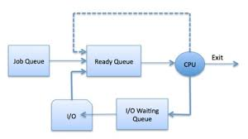
Step 2: Schedule w/Ready Queue
Create a ready priority queue
  typedef uint16_t* PQ; // priority queue
  PQueue rq; // ready queue
  rq = (int*)malloc(MAX_TASKS * sizeof(int));
  rq[0] = 0; // init ready queue
rq[5]
rq[4] | 10 / 3
rq[3] | 5 / 2
rq[2] | 5 / 0
rq[1] | 2 / 1
rq[0] | 4
rq[5]
rq[4] | 10 / 3
rq[3] | 5 / 2
rq[2] | 5 / 0
rq[1] | 2 / 1
rq[0] | 4
Add new task to ready queue in createTask
  enQ(rq, tid, tcb[tid].priority);
  NOTE: priority = tcb[tid].priority
Change scheduler() to deQ/enQ next task
  if ((tid = deQ(rq, -1)) >= 0)
  {
  enQ(rq, tid, tcb[tid].priority);
  }

Slide 11
2-State Scheduler
enQ(rq, tid, tcb[tid].priority) in createTask
createTask()
dispatch()
killTask()
Ready
Queue
New
Running
Exit
swapTask()
if ((tid = deQ(rq, -1)) >= 0)
enQ(rq, tid, tcb[tid].priority);

Slide 12
Chapter 3
Process Description and Control
The concept of process is fundamental to the structure of modern computer operating systems. Its evolution in analyzing problems of synchronization, deadlock, and scheduling in operating systems has been a major intellectual contribution of computer science.
Research Study, MIT Press, 1980

Slide 13
Chapter 3 Learning Objectives
Define the term process and explain the relationship between processes and process control blocks.
Explain the concept of a process state and discuss the state transitions the processes undergo.
List and describe the purpose of the data structures and data structure elements used by an OS to manage processes.
Assess the requirements for process control by the OS.
Understand the issues involved in the execution of OS code.
Assess the key security issues that relate to operation systems.
Describe the process management scheme for UNIX SVR4.

Slide 14
Questions…
What is a process?
When is a process created?
When is a process terminated?
What is a 2-state scheduling model?
What additional states are added with a 5-state model?
How does a suspended process differ from a blocked process?
What task variables are found in a Task Control Table?

Slide 15
1. What is a Process (or Task)?
Sequence of instructions that executes
  The entity that can be assigned to and executed on a processor
  A unit of activity characterized by a single sequential thread of execution
  Can be traced
Associated data needed by the program
Context
  All information the operating system needs to manage the process
  A current state and an associated set of system resources

Slide 16
OS Process Support?
Assist the execution of a process
  interleave the execution of several processes
  maximize processor utilization
  provide reasonable response time
Allocate resources to processes
  fairness
  avoid starvation / deadlock
Support inter-process activities
  communication
  user creation of processes

Slide 17
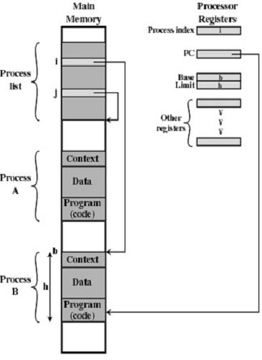
Process Implementation
Process Control Blocks
Active
Context
Process

Slide 18
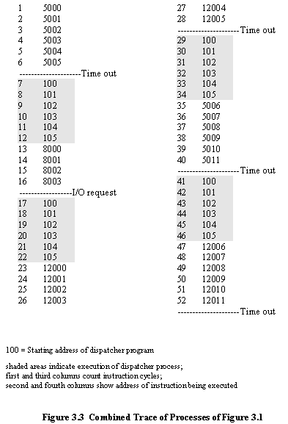
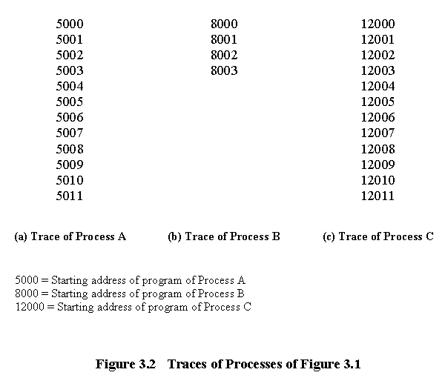
Process Trace
An instruction trace reveals the overhead required to multi-process.

Slide 19
2. When is a Process Created?
Submission of a batch job
User logs on
Created to provide a service such as printing
Process creates another process
  Modularity
  Parallelism
  Parent – child relationship
Deciding how to allocate the resources is a policy that is determined by the OS

Slide 20
Process Creation Decisions
Resource Allocation
  Treat as a new process
  Divide parent’s resources among children
Execution
  child runs concurrently with parent
  parent waits until some or all children terminate
Address Space
  copy of parent
  new program loaded into address space

Slide 21
Example: Unix Process Creation
A new process is created by the fork call
Child and parent are identical
  child returns a 0
  parent returns nonzero
Both parent and child execute next line
Often the child executes an exec
  creates a brand new process in its space
Parent can execute a wait

Slide 22
Unix Example
fork() returns:
-1 = error
0 = child
>0 = parent
switch (child1 = fork())
{ case –1: printf("Can't fork");
exit(-1);
case 0: child1P(one2two, two2one); // child 1
exit(-2);
default: switch (child2 = fork()) // parent
{ case –1: printf("Can't fork");
exit(-1);
case 0: child2P(one2two, two2one);
exit(-3);
default: // Wait for child two
waitpid(child2, status2, options);
}
/* Wait for child one */
waitpid(child1, status1, options);
fflush(stdout);
}
waitpid() joins parent & child

Slide 23
Windows NT process creation
Windows subsystem has no understanding of parent / child relationship.
Process created by CreateProcess system call
  Similar to fork-execve model
  No process group concept
  Child executes concurrently with parent
  Loads a program into the address space of the child process
Processes are objects and have handles
  Parent uses WaitForSingleObject() function to wait for child process termination.

Slide 24
Windows NT Example
// Now create the child process.
PROCESS_INFORMATION piProcInfo;
STARTUPINFO siStartInfo;
// Set up members of STARTUPINFO structure.
ZeroMemory( &siStartInfo, sizeof(STARTUPINFO) );
siStartInfo.cb = sizeof(STARTUPINFO);
// Create the child process.
CreateProcess(NULL,
program, // command line
NULL, // process security attributes
NULL, // primary thread security attributes
TRUE, // handles are inherited
0, // creation flags
NULL, // use parent's environment
NULL, // use parent's current directory
&siStartInfo, // STARTUPINFO pointer
&piProcInfo); // receives PROCESS_INFORMATION

Slide 25
3. When is a Process Terminated?
User logs off
Normal completion
Batch issues Halt
Time limit exceeded
Memory unavailable
Bounds violation
Protection error
  example write to read-only file
Arithmetic error
Time overrun
  event timeout
I/O failure
Invalid instruction
  tried to execute data
Privileged instruction
Data misuse
Operating system intervention
  such as when deadlock occurs
Parent terminates so child processes terminate
Parent request

Slide 26
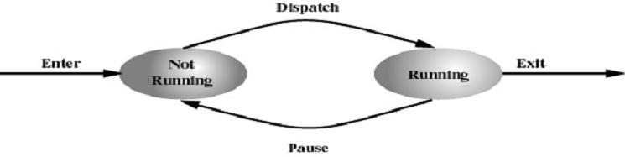
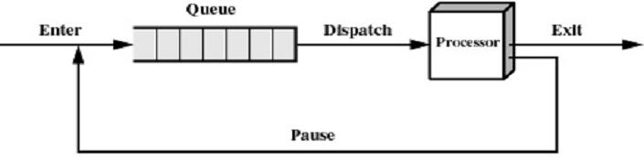
4. What is a 2-State Scheduling Model?
Process may be in one of two states
  Running
  Not-running

Slide 27
Two-state Model Problems
What does not-running mean?
  Ready to execute?
  Blocked?
  Suspended?
  Terminated?
  Priority?
Scheduler/dispatcher cannot just select the process that has been in the queue the longest.
Challenge to make overall system as “efficient” and “fair” as possible.

Slide 28
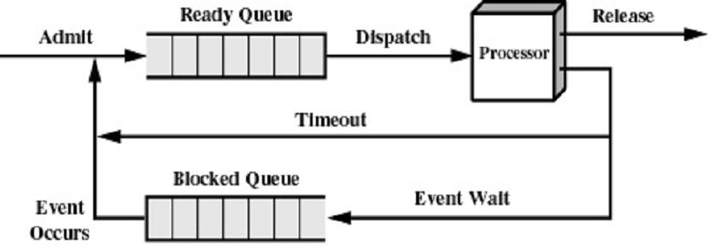
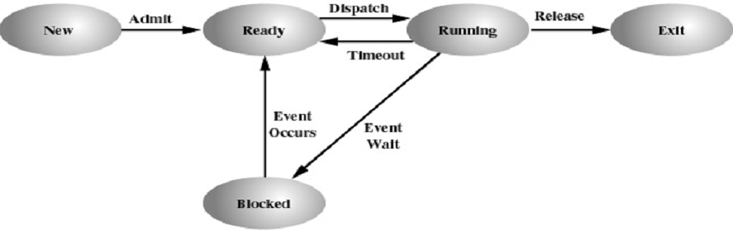
5. What is a 5-State Scheduling Model?

Slide 29
Five-state Model Transitions
  Null → New: Process is created
  New → Ready: O.S. is ready to
  handle another process (Admit)
  Ready → Running: Select another
  process to run (Dispatch)
  Running → Exit: Process has terminated (Release)
  Running → Ready: End of time slice or higher-priority process is ready (Timeout)
  Running → Blocked: Process waiting for event (Event Wait)
  Blocked → Ready: The event a process is waiting for has occurred, can continue (Event Occurs)
  Ready → Exit: Process terminated by O.S. or parent
  Blocked → Exit: Same reasons

Slide 30
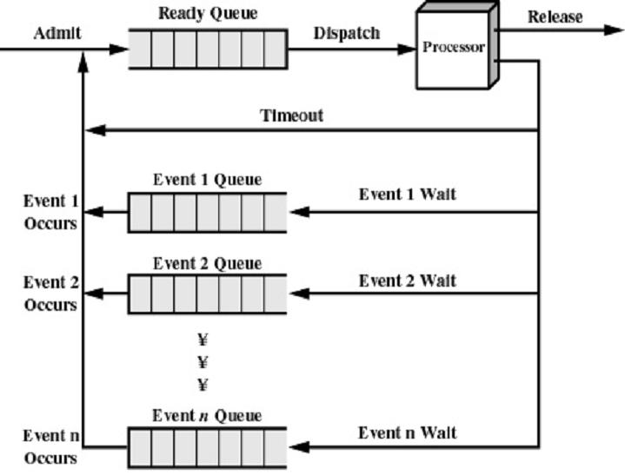
Multiple Blocked Queues

Slide 31
5-State Scheduler
#define SWAP swapTask();
#define SEM_WAIT(s) semWait(s);
#define SEM_SIGNAL(s) semSignal(s);
createTask()
dispatch()
killTask()
Ready
Queue
New
Running
Exit
swapTask()
semSignal()
semWait()
Blocked
Queues
Project 2 - Tasking

Slide 32
6. What is a Suspended Process?
Processor is faster than I/O so all processes could be waiting for I/O
Swap these processes to disk to free up more memory
Blocked state becomes suspended state when swapped to disk
Two new states
  Blocked, suspend
  Ready, suspend

Slide 33
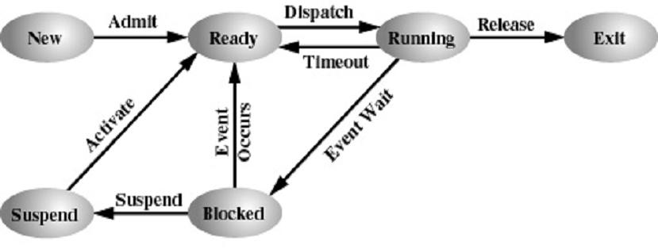
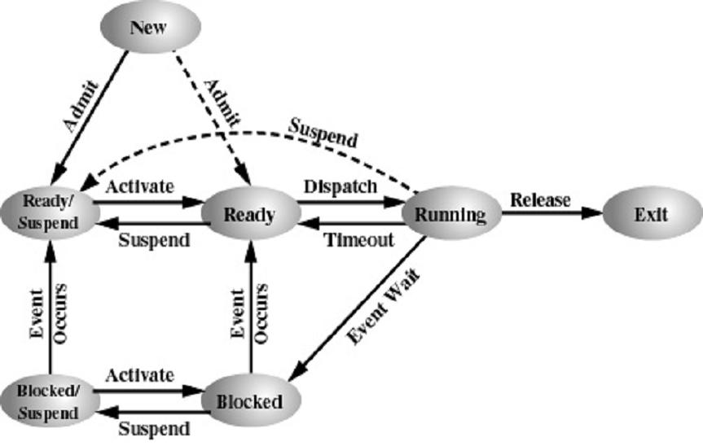
Suspended State Scheduling
One Suspend State
Two Suspend State

Slide 34
Reasons for Process Suspension
Swapping
  The OS needs to release sufficient main memory to bring in a process that is ready to execute
Other OS reason
  The OS may suspend a background or utility process or a process that is suspected of causing a problem
Interactive user request
  A user may wish to suspend execution of a program for purposes of debugging or in connection with the use of a resource
Timing
  A process may be executed periodically and may be suspended while waiting for the next time interval
Parent process request
  A parent process may wish to suspend execution of a descendent to examine or modify the suspended process

Slide 35
Chapter 3 Learning Objectives
Define the term process and explain the relationship between processes and process control blocks.
Explain the concept of a process state and discuss the state transitions the processes undergo.
List and describe the purpose of the data structures and data structure elements used by an OS to manage processes.
Assess the requirements for process control by the OS.
Understand the issues involved in the execution of OS code.
Assess the key security issues that relate to operation systems.
Describe the process management scheme for UNIX SVR4.

Slide 36
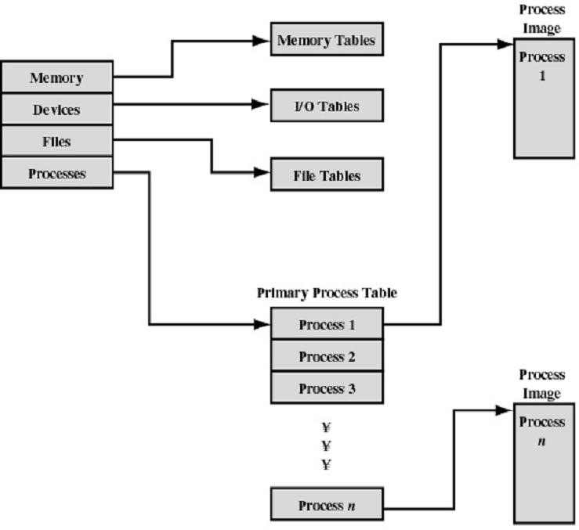
7. Operating System Control Tables
OS Tables
Task Control
Blocks

Slide 37
Control Tables
Memory Tables
  Allocation of main memory to processes
  Allocation of secondary memory to processes
  Protection attributes for access to shared memory regions
  Information needed to manage virtual memory
I/O device is available or assigned
  Status of I/O operation
  Location in main memory being used as the source or destination of the I/O transfer

Slide 38
Control Tables
File Tables
  Existence of files
  Location on secondary memory
  Current Status
  Attributes
  Usually maintained by a file management system
Process Table
  Process ID
  Process state
  Location in memory

Slide 39
Process Location
Process includes set of programs to be executed
  Data locations for local and global variables
  Any defined constants
  Stack
Process Control Block (PCB)
  Collection of attributes
Process image
  Collection of program, data, stack, and attributes

Slide 40
Task Control Block (tcb)
// task control block
typedef struct // task control block
{ char* name; // task name (P1)
int (*task)(int,char**); // task address (P1)
int state; // task state (P2)
int priority; // task priority (P2)
int argc; // task argument count (P1)
char** argv; // task argument pointers (P1)
int signal; // task signals (P1)
void (*sigContHandler)(void); // task mySIGCONT handler (P1)
void (*sigIntHandler)(void); // task mySIGINT handler (P1)
void (*sigTermHandler)(void); // task mySIGTERM handler (P1)
void (*sigTstpHandler)(void); // task mySIGTSTP handler (P1)
TID parent; // task parent (P1)
int RPT; // task root page table (P4)
int cdir; // task directory (P6)
Semaphore *event; // blocked task semaphore (P2)
void* stack; // task stack (P2)
jmp_buf context; // task context pointer (P2)
} TCB;

Slide 41
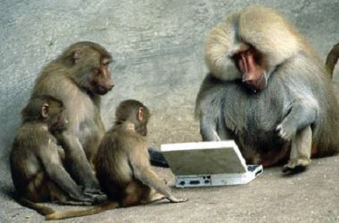

Be Safe

